Slide 1
CIG Tectonics Modeling Tutorial
Overview and Schedule
Session 1. Introduction to ASPECT Basics
Session 2. Modifying and Coding in ASPECT
Session 3. Lithospheric Deformation*
Overview of Viscoelasticity, Nonlinear Viscous Flow and Plasticity
Example: (Bending Beam)
Example: Continental Extension
Example: Brittle Thrust Wedge
Example: Subduction
Session 4. Two-Phase Flow
Session 5. Complex Model Design with the World Builder

Slide 2
Example: Bending Beam Benchmark
Instructions:
1. Open a terminal and cd to the tutorial directory
cd ~/aspect-tutorials/2020-tectonics-modeling-tutorial/session-3/
2. Optional (if running in release mode):
Open the file
leafpad viscoelastic_bending_beam.prm
Change
”set End time = 10e3” to ”set End time = 50e3”
3. Run the model:
mpirun -np 2 ~/aspect/aspect-release viscoelastic_bending_beam.prm

Slide 3
Introductory Notes
There are a huge number of contributors to the lithospheric dynamics components of ASPECT: All maintainers/developers and many contributors
Computational lithospheric dynamics is vast topic and this tutorial is meant as an introduction, rather than a comprehensive review. The next step is to review the additional examples in ASPECT (cookbooks, benchmarks), ASPECT source code, and vast literature on this subject (all codes).
Nonlinear lithospheric dynamics is difficult - properly set your expectations for the time required to conduct a novel study.

Slide 4
Numerical Modeling From Start to Finish
Define what physical processes to examine
Capture the physics through equations
Choose a numerical approximation to solve the equations
Design, write and validate software (or validate existing code)
Formulate a hypothesis to test
Design and run a series of models
Verify and interpret results
*Do not skip steps 1 and 5 under any circumstances

Slide 5
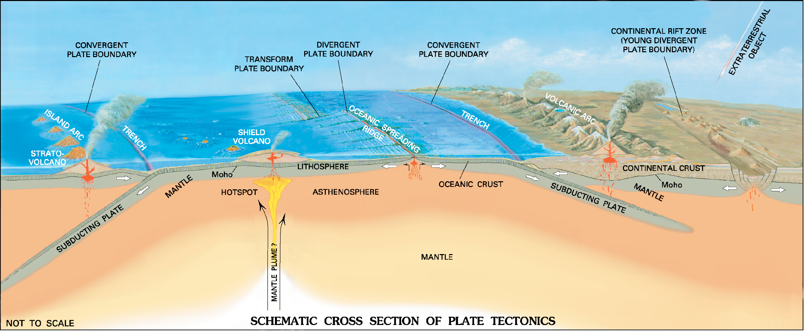
Physical Processes: Long-Term Tectonics
USGS, 2006
Crustal Deformation, Lithospheric Deformation, Mantle Convection

Slide 6
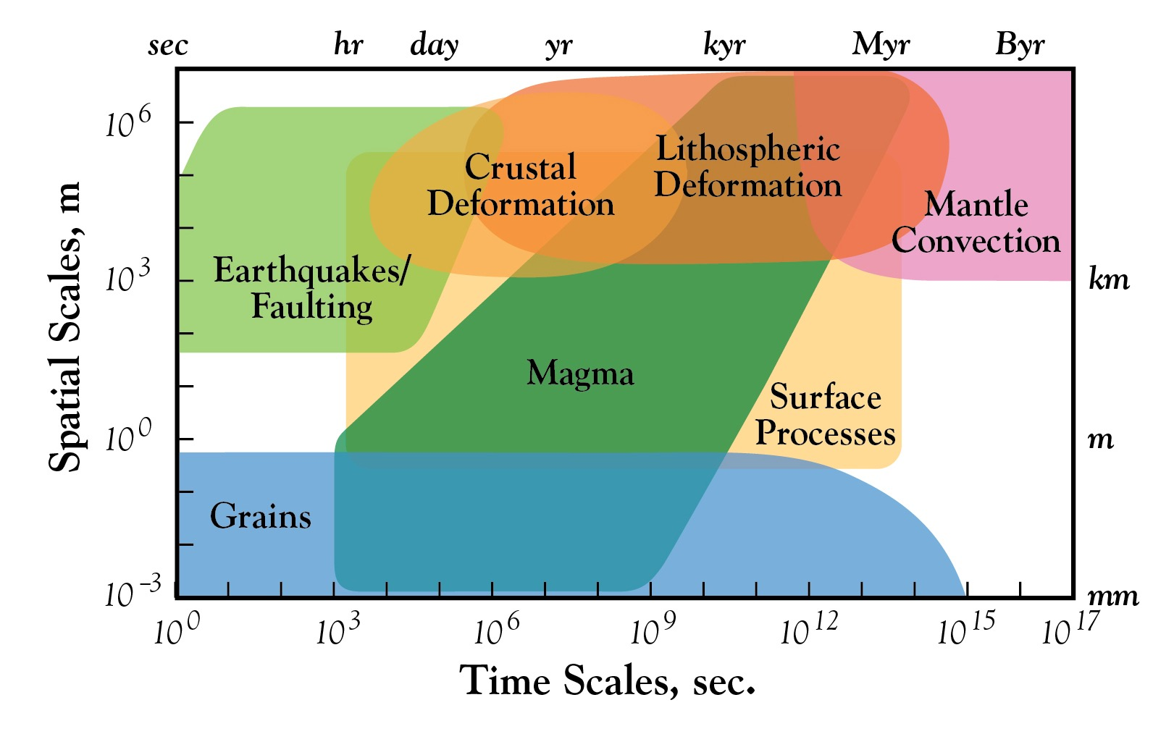
Relevant Temporal and Spatial Scales
Cooper et al., 2015, GSA Today
Tectonics:
10⁰ to 10⁸ years, <10 to 1000’s of km

Slide 7
Capture Physics Through Equations
Governing Equations (Incompressible Viscous Flow)
1. Stokes Equations
$$∇∙u=0$$
$$∇∙σ^{′}−∇P+ρg=0$$
2. Conservation of Energy
$$ρc\left(\frac{∂T}{∂t}+u∙∇T\right)=∇∙K∇T+H$$

Slide 8
Capture Physics Through Equations
1. Calculate an Effective Viscoelastic Viscosity
$$η_{ve}=η\frac{∆t^{e}}{∆t^{e}+\frac{η}{μ}}$$
2. Calculate the Viscoelastic Stress Accumulation
$$σ^{t+∆t^{e}}=η_{ve}\left(2{\dot{ε}}^{t+∆t^{e}}+\frac{σ^{t}}{μ∆t^{e}}+\frac{W^{t}σ^{t}−σ^{t}W^{t}}{μ}\right)$$
3. Add viscoleastic force term to the force-balance equation
$F^{e,t}=−\frac{η_{ve}}{μ∆t^{e}}σ^{t}$ $∇∙σ^{′}−∇P+ρg=0$
4. Track stresses with advected field or particles*
*Approach from Moresi et al., 2003

Slide 9
Capture Physics Through Equations
Constitutive Relationships (Rheology)
1. Nonlinear viscous flow (diffusion, dislocation, or composite creep)
$σ_{v}=A^{−1/n}{\dot{ε}}^{−1/n}d^{m/n}e^{\frac{E+PV}{nRT}}$ , $η_{v}=\frac{1}{2}A^{−1/n}{\dot{ε}}^{\left(1−n\right)/n}d^{m/n}e^{\frac{E+PV}{nRT}}$
2. Viscoelasticity
$η_{ve}=η\frac{∆t^{e}}{∆t^{e}+\frac{η}{μ}}$, $F^{e,t}=−\frac{η_{ve}}{μ∆t^{e}}σ^{t}$
3. Plasticity (Drucker Prager)
$σ_{y}=P\sin{∅}+C\cos{∅}$, $η_{p}=\frac{σ_{y}}{\dot{ε}}$, for $∅\left(ε_{p}\right),C\left(ε_{p}\right)$

Slide 10
Additional Notes on Rheology
These nonlinear systems of equations is not trivial to solve – requires global, and sometimes local, nonlinear iterations to solve.
Frequently, varying the model design significantly changes the required number of nonlinear iterations. For large, time-dependent 3D simulations, doing 50-100 nonlinear iterations (for example) per time step is not practical.
Relevant ASPECT papers:
Dannberg et al. (2017)
Glerum et al. (2018)
Naliboff et al. (2020)

Slide 11
Formulate a Hypothesis to Test
Controls on deformation patterns?
rheology, rates of deformation, initial lithospheric structure …
Continental extension, subduction, thrust sheets

Slide 12
Viscoelasticity: Where is it important?
The lithosphere deformation through of viscous, plastic (brittle), and elastic deformation
Elastic deformation is important in regions undergoing flexure*

Slide 13
Viscoelasticity in ASPECT
Material Models: Viscoelastic and ViscoPlastic
Rheology Module: Elasticity
Benchmarks
viscoelastic_bending_beam, viscoelastic_beam_modified
viscoelastic_stress_build-up
viscoelastic_plate_flexure
free_surface_tractions
viscoelastic_plastic_shear_bands
viscoelastic_plstic_simple_shear
* No paper yet, but lots of documentation within ASPECT
Open prm file: leafpad viscoelastic_bending_beam.prm

Slide 14
Viscoelastic Bending Beam Overview
Free Slip
7.5x5 km
100 m grid
Gravity
No Slip
Viscoelastic, Dense Beam
Free Slip
Viscous, Light Fluid
Free Slip
Dense viscoselastic beam within a low density and viscous fluid subject to gravity.

Slide 15
Viscoelastic Bending Beam Overview
The beam undergoes viscoelastic flexure

Slide 16
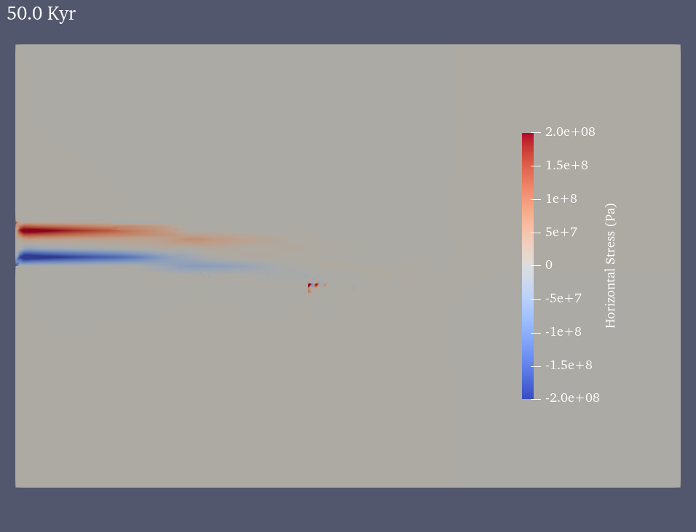
Viscoelastic Bending Beam Overview
Viscoelastic stresses accumulate

Slide 17
Viscoelastic Bending Beam Key Features
Global Parameters
set End time = 10e3
set CFL number = 0.5
Set Maximum timestep = 1e3
Driving Forces
subsection Gravity model
set Model name = vertical
subsection Vertical
set Magnitude = 10
end
end
Checkpointing
set Resume computation = auto
subsection Checkpoint
set Steps between checkpoint = 10
end

Slide 18
Viscoelastic Bending Beam Key Features
Number and name of compositional fields
subsection Compositional fields
set Number of fields = 4
set Names of fields = stress_xx, stress_yy, stress_xy, beam
end
Composition initial conditions
subsection Initial composition model
set Model name = function
subsection Function
set Variable names = x,y
set Function constants =
set Function expression = 0; 0; 0; if (x<=4.5e3 && y>=2.5e3 && y<=3.0e3, 1, 0)
end
end

Slide 19
Viscoelastic Bending Beam Key Features
Discretization (element types)
subsection Discretization
set Composition polynomial degree = 2
set Stokes velocity polynomial degree = 2
set Temperature polynomial degree = 1
set Use locally conservative discretization = false
set Use discontinuous temperature discretization = false
set Use discontinuous composition discretization = true
subsection Stabilization parameters
set Use limiter for discontinuous composition solution = true
set Global composition maximum = 1.e11, 1.e11, 1.e11, 1.0
set Global composition minimum = -1.e11, -1.e11, -1.e11, 0.0
end
end
*Temperature is constant: use a low-order element
*Use DG to accurately track beam

Slide 20
Viscoelastic Bending Beam Key Features
Governing Equations
subsection Formulation
set Enable elasticity = true
end
Rheology
subsection Material model
set Model name = viscoelastic
subsection Viscoelastic
set Densities = 2800, 2800, 2800, 2800, 3300
set Viscosities = 1.e18, 1.e18, 1.e18, 1.e18, 1.e24
set Elastic shear moduli = 1.e11, 1.e11, 1.e11, 1.e11, 1.e10
set Fixed elastic time step = 1e3
set Use fixed elastic time step = false
set Use stress averaging = false
set Viscosity averaging scheme = maximum composition
end
end

Slide 21
Viscoelastic Bending Beam Key Features
Governing Equations
subsection Formulation
set Enable elasticity = true
end
Rheology
subsection Material model
set Model name = viscoelastic
subsection Viscoelastic
set Densities = 2800, 2800, 2800, 2800, 3300
set Viscosities = 1.e18, 1.e18, 1.e18, 1.e18, 1.e24
set Elastic shear moduli = 1.e11, 1.e11, 1.e11, 1.e11, 1.e10
set Fixed elastic time step = 1e3
set Use fixed elastic time step = false
set Use stress averaging = false
set Viscosity averaging scheme = maximum composition
end
end

Slide 22
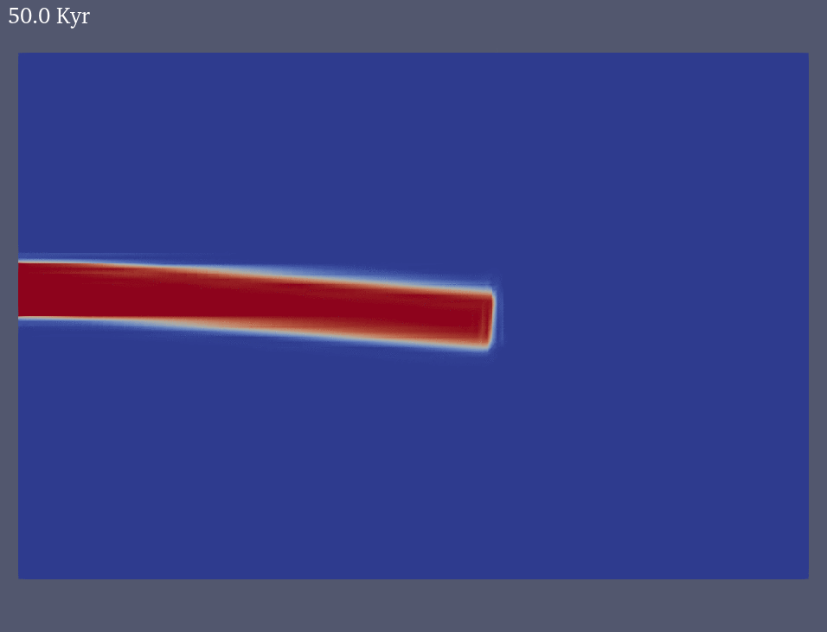
Viscoelastic Bending Beam Overview
Beam unbends when gravity is turned off

Slide 23
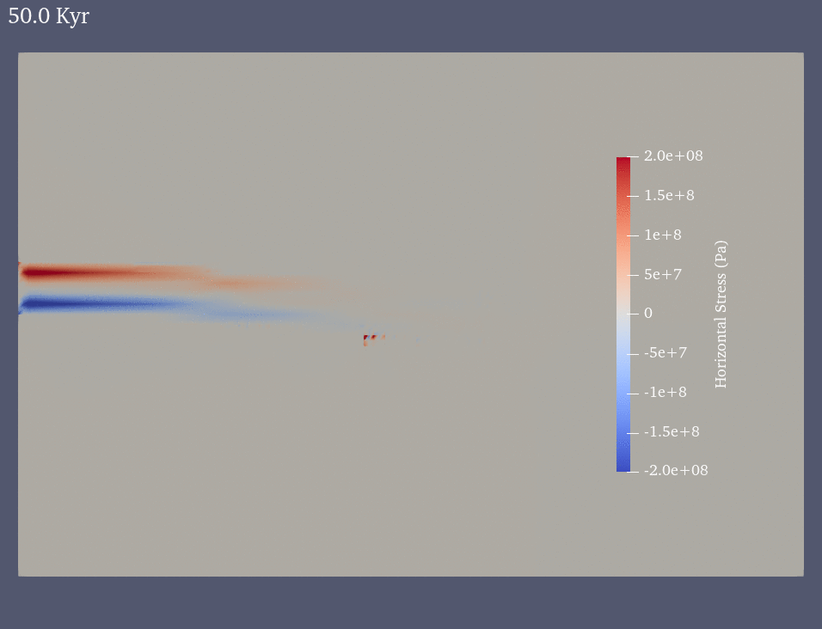
Viscoelastic Bending Beam Overview
... and stresses relax

Slide 24
Things to try during the break
Turning off gravity and restarting the model:
1. Change the end time to 250 Kyr: ”set End time = 250e3”
2. Turn off gravity
subsection Gravity model
set Model name = vertical
subsection Vertical
set Magnitude = 0
end
end
3. The model will automatically start from where you left off
set Resume computation = auto
mpirun -np 2 ~/aspect/aspect-release viscoelastic_bending_beam.prm

Slide 25
Continental Extension
Divergent plate boundary forces
A wide range of deformation mechanisms (brittle, viscous, elastic)
Magmatism
Potentially breakup of the continental plate and oceanic spreading

Slide 26
Simple Extension Model Design
Velocity Boundary Conditions
y = 0 km
Free Surface ~ Stress Free (V_{y} = free, V_{x} = free)
T = 0º C
Non-linear flow law
Brittle Yield Criterion
Crust (30 km)
2700 kg m⁻³
T = 500º C
Weak Seed
Non-linear flow law
Brittle Yield Criterion
Mantle (70 km)
V_{y}: free
V_{x}: fixed
3300 kg m⁻³
V_{y}: free
V_{x}: fixed
(V_{y}: fixed, V_{x}: free)
T = 1200º C
x = 0 km
y = 100 km
x = 200 km
y = 100 km

Slide 27
ASPECT Continental Extension Cookbook
$ASPECT_DIR/cookbooks/continental_extension.prm

Slide 28
Modified Continental Extension Cookbook
Instructions:
1. Open a terminal and cd to the tutorial directory
cd ~/aspect-tutorials/2020-tectonics-modeling-tutorial/session-3/
2. Optional: Change ”set End time = 1e6” to ”set End time = 5e6”
3. Run the model:
mpirun -np 2 ~/aspect/aspect-release continental_extension.prm
Changes to continental extension cookbook?
Lithospheric structure
Strain softening
Initiation of deformation with plastic strain
Advection of free surface
Solver scheme
Initial mesh refinement

Slide 29
Modified Continental Extension Cookbook
Global Parameters
set Dimension = 2
set Start time = 0
set End time = 1e6
set Use years in output instead of seconds = true
set Nonlinear solver scheme = single Advection, iterated Newton Stokes
set Nonlinear solver tolerance = 1e-4
set Max nonlinear iterations = 10 # Normally set to 50 or 100
set CFL number = 0.5
set Maximum time step = 50e3 # Normally set to 20 Kyr
Additional nonlinear solver options
set Nonlinear solver scheme = single Advection, iterated Stokes
set Nonlinear solver scheme = iterated Advection and Stokes

Slide 30
Modified Continental Extension Cookbook
Nonlinear Iterations (example output)
Number of mesh deformation degrees of freedom: 1722
*** Timestep 0: t=0 years
Solving mesh velocity system... 0 iterations.
Solving temperature system... 0 iterations.
Skipping noninitial_plastic_strain composition solve because RHS is zero.
Solving plastic_strain system ... 0 iterations.
Solving crust_upper system ... 0 iterations.
Solving crust_lower system ... 0 iterations.
Solving mantle_lithosphere system ... 0 iterations.
Initial Newton Stokes residual = 1.4008e+15, v = 1.40072e+15, p = 1.47326e+13
Rebuilding Stokes preconditioner...
Solving Stokes system... 0+22 iterations.
Relative nonlinear residual (total Newton system) after nonlinear iteration 1: 1, norm of the rhs: 1.4008e+15
Rebuilding Stokes preconditioner...
Solving Stokes system... 0+23 iterations.
Relative nonlinear residual (total Newton system) after nonlinear iteration 2: 0.012105, norm of the rhs: 1.69566e+13, newton_derivative_scaling_factor: 0
The linear solver tolerance is set to 0.1.
Rebuilding Stokes preconditioner...
Solving Stokes system... 0+1 iterations.
Relative nonlinear residual (total Newton system) after nonlinear iteration 3: 0.00365796, norm of the rhs: 5.12405e+12, newton_derivative_scaling_factor: 0

Slide 31
Modified Continental Extension Cookbook
Model geometry and pre-refinement grid spacing
# Model geometry (200x100 km, 20 km spacing)
subsection Geometry model
set Model name = box
subsection Box
set X repetitions = 10
set Y repetitions = 5
set X extent = 200e3
set Y extent = 100e3
end
end

Slide 32
Modified Continental Extension Cookbook
Model geometry and pre-refinement grid spacing
# Adaptively refine the mesh to 2.5 km spacing above y=50 km
# and between x=40 and x=160 km. These values ensure areas
# undergoing brittle deformation are in the high-resolution region.
subsection Mesh refinement
set Initial global refinement = 2
set Initial adaptive refinement = 1
set Time steps between mesh refinement = 0
set Strategy = minimum refinement function
subsection Minimum refinement function
set Coordinate system = cartesian
set Variable names = x,y
set Function expression = if ( y>=50e3 && x>=40.e3 && x<=160.e3, 3, 2)
end
set Run postprocessors on initial refinement = false
end
Global grid spacing is 5 km
2.5 km grid spacing in select region

Slide 33
Modified Continental Extension Cookbook
Solver Settings
Newton Solver Resources
Fraters et al. (2019): Efficient and practical Newton solvers for non-linear Stokes systems in geodynamic problems.
Manual
Benchmarks:
~/aspect/benchmarks/newton_solver_benchmark_set
subsection Solver parameters
subsection Stokes solver parameters
set Stokes solver type = block AMG
set Number of cheap Stokes solver steps = 0
end
subsection Newton solver parameters
set Max Newton line search iterations = 5
set Max pre-Newton nonlinear iterations = 10
set Maximum linear Stokes solver tolerance = 1e-1
set Nonlinear Newton solver switch tolerance = 1e-4
set SPD safety factor = 0.9
set Stabilization preconditioner = SPD
set Stabilization velocity block = SPD
set Use Newton failsafe = false
set Use Newton residual scaling method = false
set Use Eisenstat Walker method for Picard iterations = true
end
end
Never switch Newton Solver on
Modifies linear solver tolerance

Slide 34
Modified Continental Extension Cookbook
Velocity Boundary Conditions
# Velocity on boundaries characterized by functions
# The outward velocity (x-direction) on the left and right walls is 0.25 cm/year.
# The vertical velocity at the base is 0.25 cm/year (balances outflow on sides).
# Velocity components parallel to the base (x-velocity) and side walls (y-velocity)
# are unconstrained (i.e. 'free').
subsection Boundary velocity model
set Prescribed velocity boundary indicators = left x: function, right x:function, bottom y:function
subsection Function
set Variable names = x,y
set Function constants = v=0.0025, c=100.e3, w=200.e3, d=100.e3
set Function expression = if (x<c , -v, v); v*2*d/w
end
end

Slide 35
Modified Continental Extension Cookbook
Initial Composition
subsection Compositional fields
set Number of fields = 5
set Names of fields = noninitial_plastic_strain, plastic_strain, crust_upper, crust_lower, mantle_lithosphere
end
not rock types!
subsection Initial composition model
set Model name = function
subsection Function
set Variable names = x,y
set Function expression = 0; \
if(x>50.e3 && x<150.e3 && y>50.e3, 0.5 + rand()*1.0, 0); \
if(y>=80.e3, 1, 0); \
if(y<80.e3 && y>=60.e3, 1, 0); \
if(y<60.e3 && y>=0.e3, 1, 0);
end
end

Slide 36
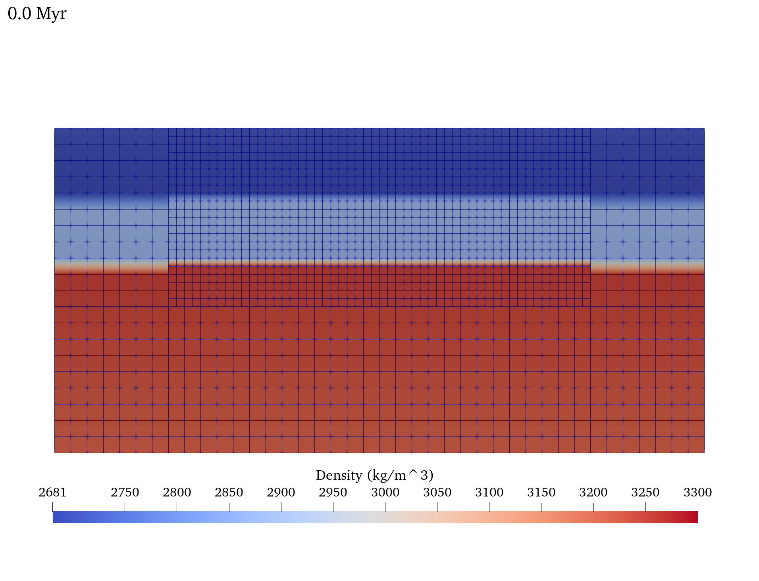
Modified Continental Extension Cookbook
Initial density structure (lithology, temperature)

Slide 37
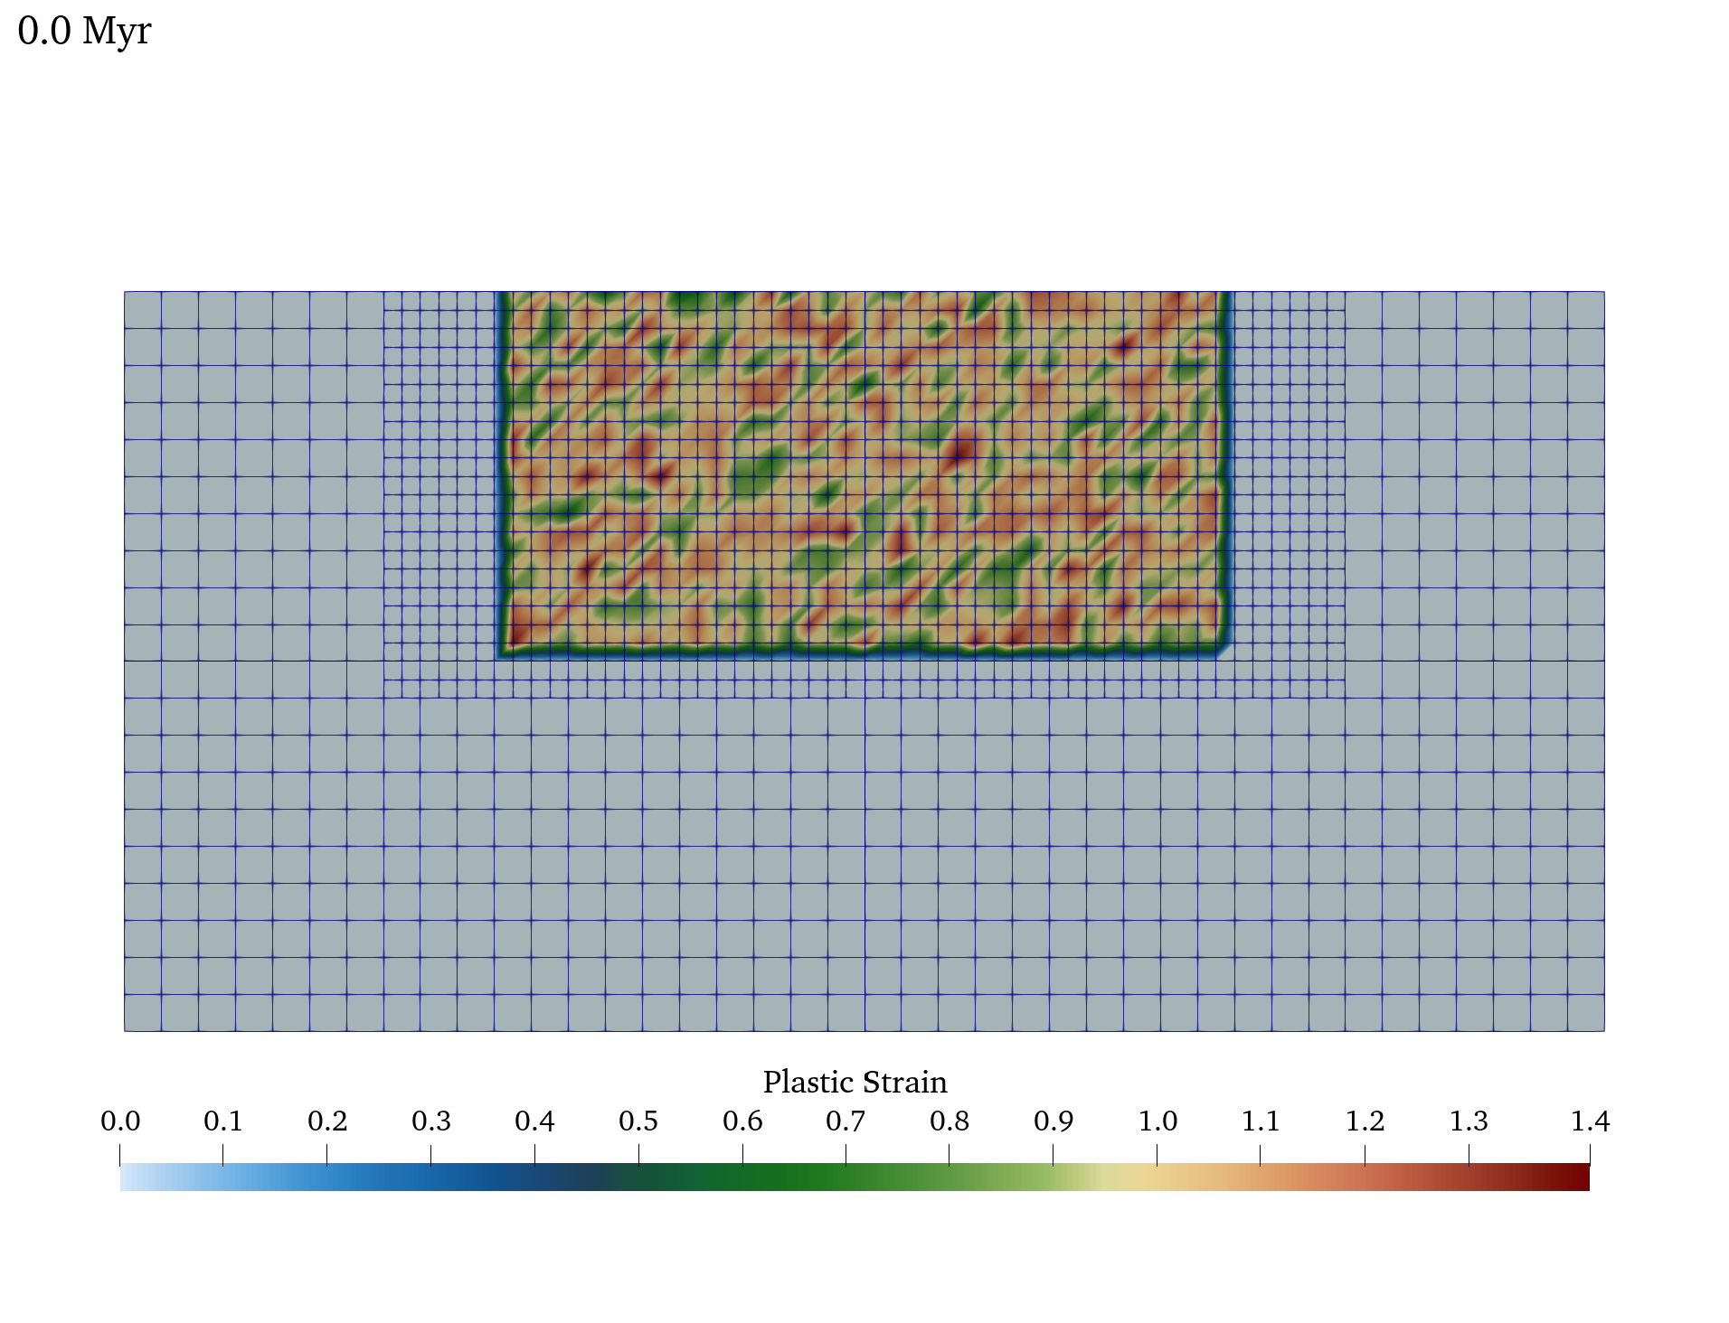
Modified Continental Extension Cookbook
Initial density structure (lithology, temperature)

Slide 38
Modified Continental Extension Cookbook
Temperature boundary conditions
subsection Boundary temperature model
set Fixed temperature boundary indicators = bottom, top
set Model name = initial temperature
end
Sides are insulating
Temperature initial conditions (part 1)
# Chapman (1986) equations for continental lithosphere geotherm:
# T(z) = Tt + (qt/k)*z - (A*z**2)/(2*k) (eq 4)
# Tb = Tt + (qt/k)*dz - (A*dz**2)/(2*k) (eq 5)
# qb = qt - A*dz (eq 6)
# The initial constraints are:
# Surface Temperature - upper crust (ts1) = 273 K
# Surface Heat Flow - upper crust (qs1) = 0.055 mW/m^2
# Heat Production - upper crust (A1) = 1.00e-6 W/m^3;
# Heat Production - lower crust (A2) = 0.25e-6 W/m^3;
# Heat Production - mantle (A3) = 0.00e-6 W/m^3;
# Thermal Conductivity - all layers = 2.5 (W/(m K));
# To satisfy these constraints, the following values are required:
# Surface Temperature - lower crust (ts2) = 633 K
# - mantle (ts3) = 893 K
# Surface Heat Flow - lower crust (qs2) = 0.035 W/m^2;
# - mantle (qs3) = 0.030 W/m^2;

Slide 39
Modified Continental Extension Cookbook
Temperature initial conditions (part 2)
# Initial temperature field
subsection Initial temperature model
set List of model names = function
subsection Function
set Variable names = x,y,z
set Function constants = h=100.e3,ts1=273,ts2=633,ts3=893, \
A1=1.e-6,A2=0.25e-6,A3=0.0, \
k1=2.5,k2=2.5,k3=2.5, \
qs1=0.055,qs2=0.035,qs3=0.030
set Function expression = if( (h-y)<=20.e3, \
ts1 + (qs1/k1)*(h-y) - (A1*(h-y)*(h-y))/(2.0*k1), \
if( (h-y)>20.e3 && (h-y)<=40.e3, \
ts2 + (qs2/k2)*(h-y-20.e3) - (A2*(h-y-20.e3)*(h-y-20.e3))/(2.0*k2), \
ts3 + (qs3/k3)*(h-y-40.e3) - (A3*(h-y-40.e3)*(h-y-40.e3))/(2.0*k3) ) );
end
end

Slide 40
Modified Continental Extension Cookbook
Heating Model
subsection Heating model
set List of model names = compositional heating
subsection Compositional heating
set Compositional heating values = 0.0, 0.0, 0.0, 1.0e-6, 0.25e-6, 0.
end
end
Values need to be consistent with initial temperature model!

Slide 41
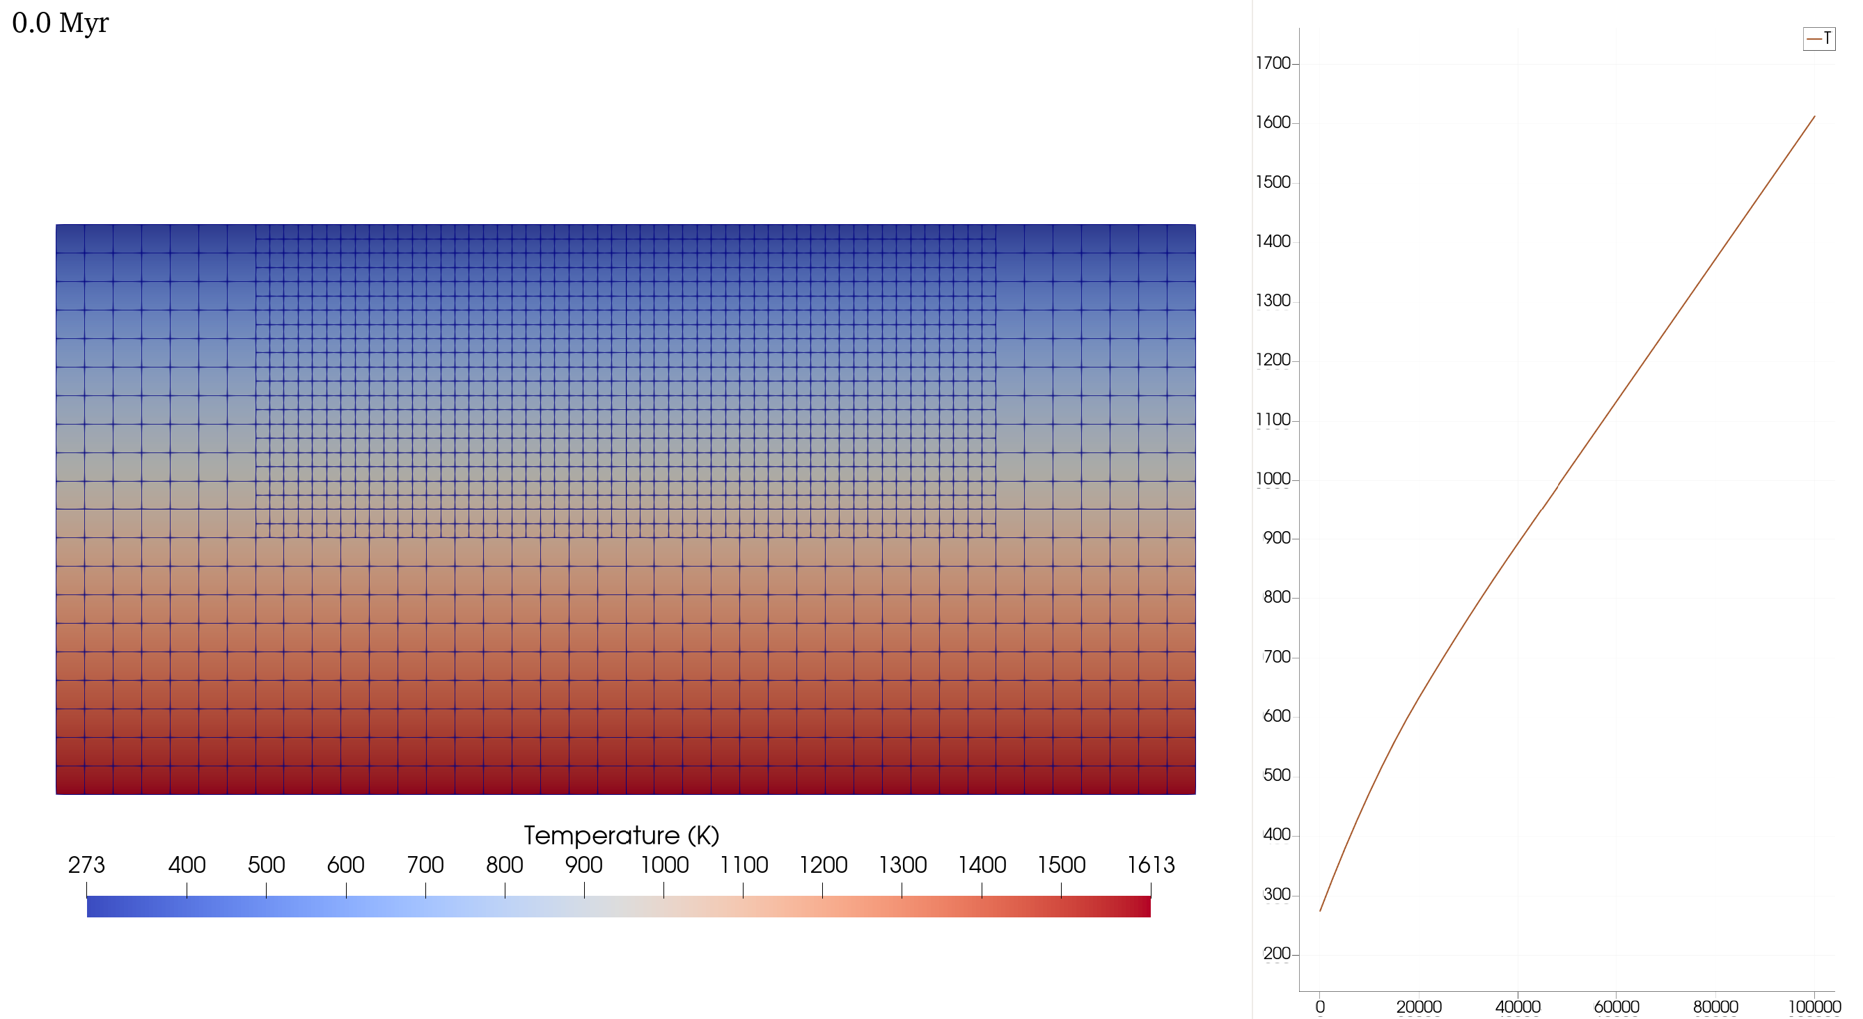
Modified Continental Extension Cookbook
Initial temperature structure

Slide 42
Modified Continental Extension Cookbook
Material Model (Part 1): Reference and min/max values
subsection Material model
set Model name = visco plastic
subsection Visco Plastic
# Reference temperature and viscosity
set Reference temperature = 273
set Reference viscosity = 1e22
# The minimum strain-rate helps limit large viscosities values that arise
# as the strain-rate approaches zero.
# The reference strain-rate is used on the first non-linear iteration
# of the first time step when the velocity has not been determined yet.
set Minimum strain rate = 1.e-20
set Reference strain rate = 1.e-16
# Limit the viscosity with minimum and maximum values
set Minimum viscosity = 1e18
set Maximum viscosity = 1e26

Slide 43
Modified Continental Extension Cookbook
Material Model (Part 2): Thermodynamic Values
set Define thermal conductivities = true
set Thermal conductivities = 2.5
set Heat capacities = 750
set Densities = 3300, 1.0, 1.0, 2700, 2900, 3300
set Thermal expansivities = 2e-5
Material Model (Part 3): Viscosity averaging
set Viscosity averaging scheme = harmonic
Material Model (Part 4a): Viscous flow law
# Choose to have the viscosity (pre-yield) follow a dislocation
# diffusion or composite flow law. Here, dislocation is selected
# so no need to specify diffusion creep parameters below, which are
# only used if "diffusion" or "composite" option is selected.
set Viscous flow law = dislocation

Slide 44
Modified Continental Extension Cookbook
Material Model (Part 4b): Viscous flow law
$σ_{v}=A^{−1/n}{\dot{ε}}^{−1/n}d^{m/n}e^{\frac{E+PV}{nRT}}$ , $η_{v}=\frac{1}{2}A^{−1/n}{\dot{ε}}^{\left(1−n\right)/n}d^{m/n}e^{\frac{E+PV}{nRT}}$
set Prefactors for dislocation creep = 6.52e-16, 1.00e-50, 1.00e-50, 8.57e-28, 7.13e-18, 6.52e-16
set Stress exponents for dislocation creep = 3.5, 1.0, 1.0, 4.0, 3.0, 3.5
set Activation energies for dislocation creep = 530.e3, 0.0, 0.0, 223.e3, 345.e3, 530.e3
set Activation volumes for dislocation creep = 18.e-6, 0.0, 0.0, 0., 0., 18.e-6
Upper Crust – Wet Quarzite (Gleason and Tullis, 1995)
Lower Crust – Wet Anorthite (Rybacki et al., 2006)
Mantle & Background – Dry Olivine (Hirth and Kholstedt, 2003)
Non-lithologies – set to clearly distinguishable value, which are not used

Slide 45
Modified Continental Extension Cookbook
Material Model (Part 5): Plasticity
set Angles of internal friction = 30.
set Cohesions = 20.e6
$σ_{y}=P\sin{∅}+C\cos{∅}$, $η_{p}=\frac{σ_{y}}{\dot{ε}}$, for $∅\left(ε_{p}\right),C\left(ε_{p}\right)$
# The parameters below weaken the friction and cohesion by a
# a factor of 4 between plastic strain values of 0.5 and 1.5.
set Strain weakening mechanism = plastic weakening with plastic strain only
set Start plasticity strain weakening intervals = 0.5
set End plasticity strain weakening intervals = 1.5
set Cohesion strain weakening factors = 0.25
set Friction strain weakening factors = 0.25
Cohesion and friction linearly weaken by a factor of between plastic strains of 0.5 and 1.5
Relevant papers: Glerum et al. (2018); Naliboff et al. (2020)

Slide 46
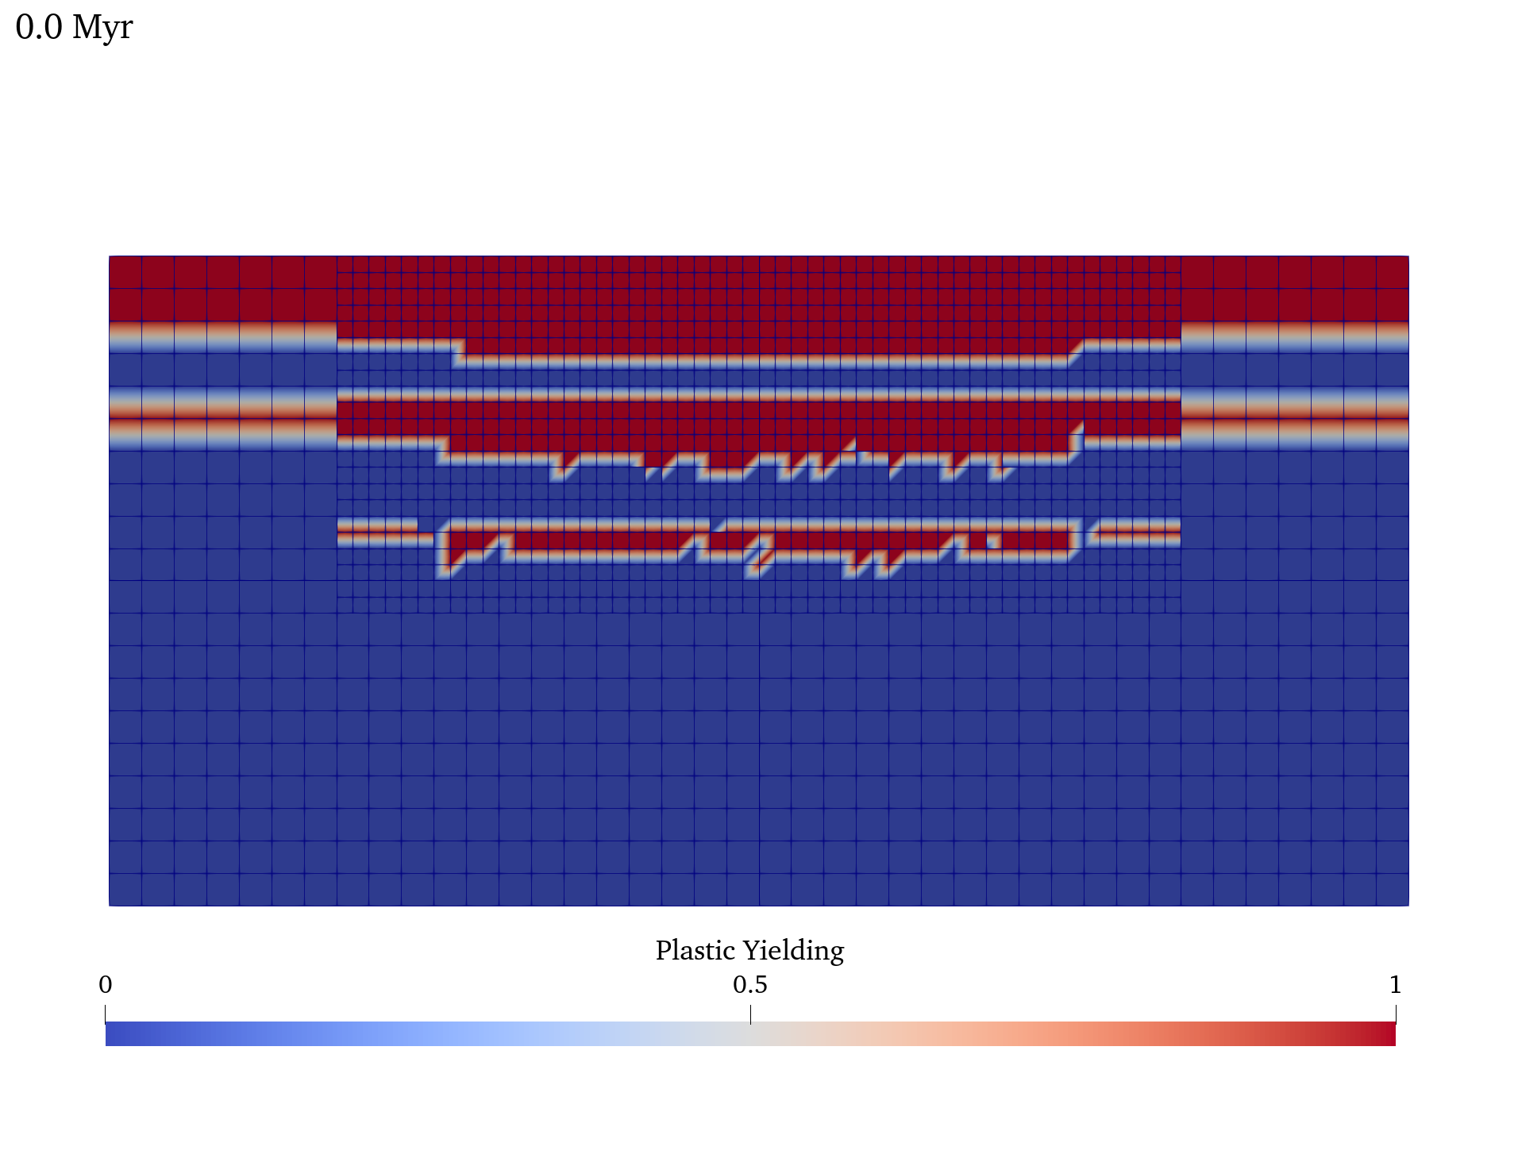
Modified Continental Extension Cookbook
Initial Deformation Field

Slide 47
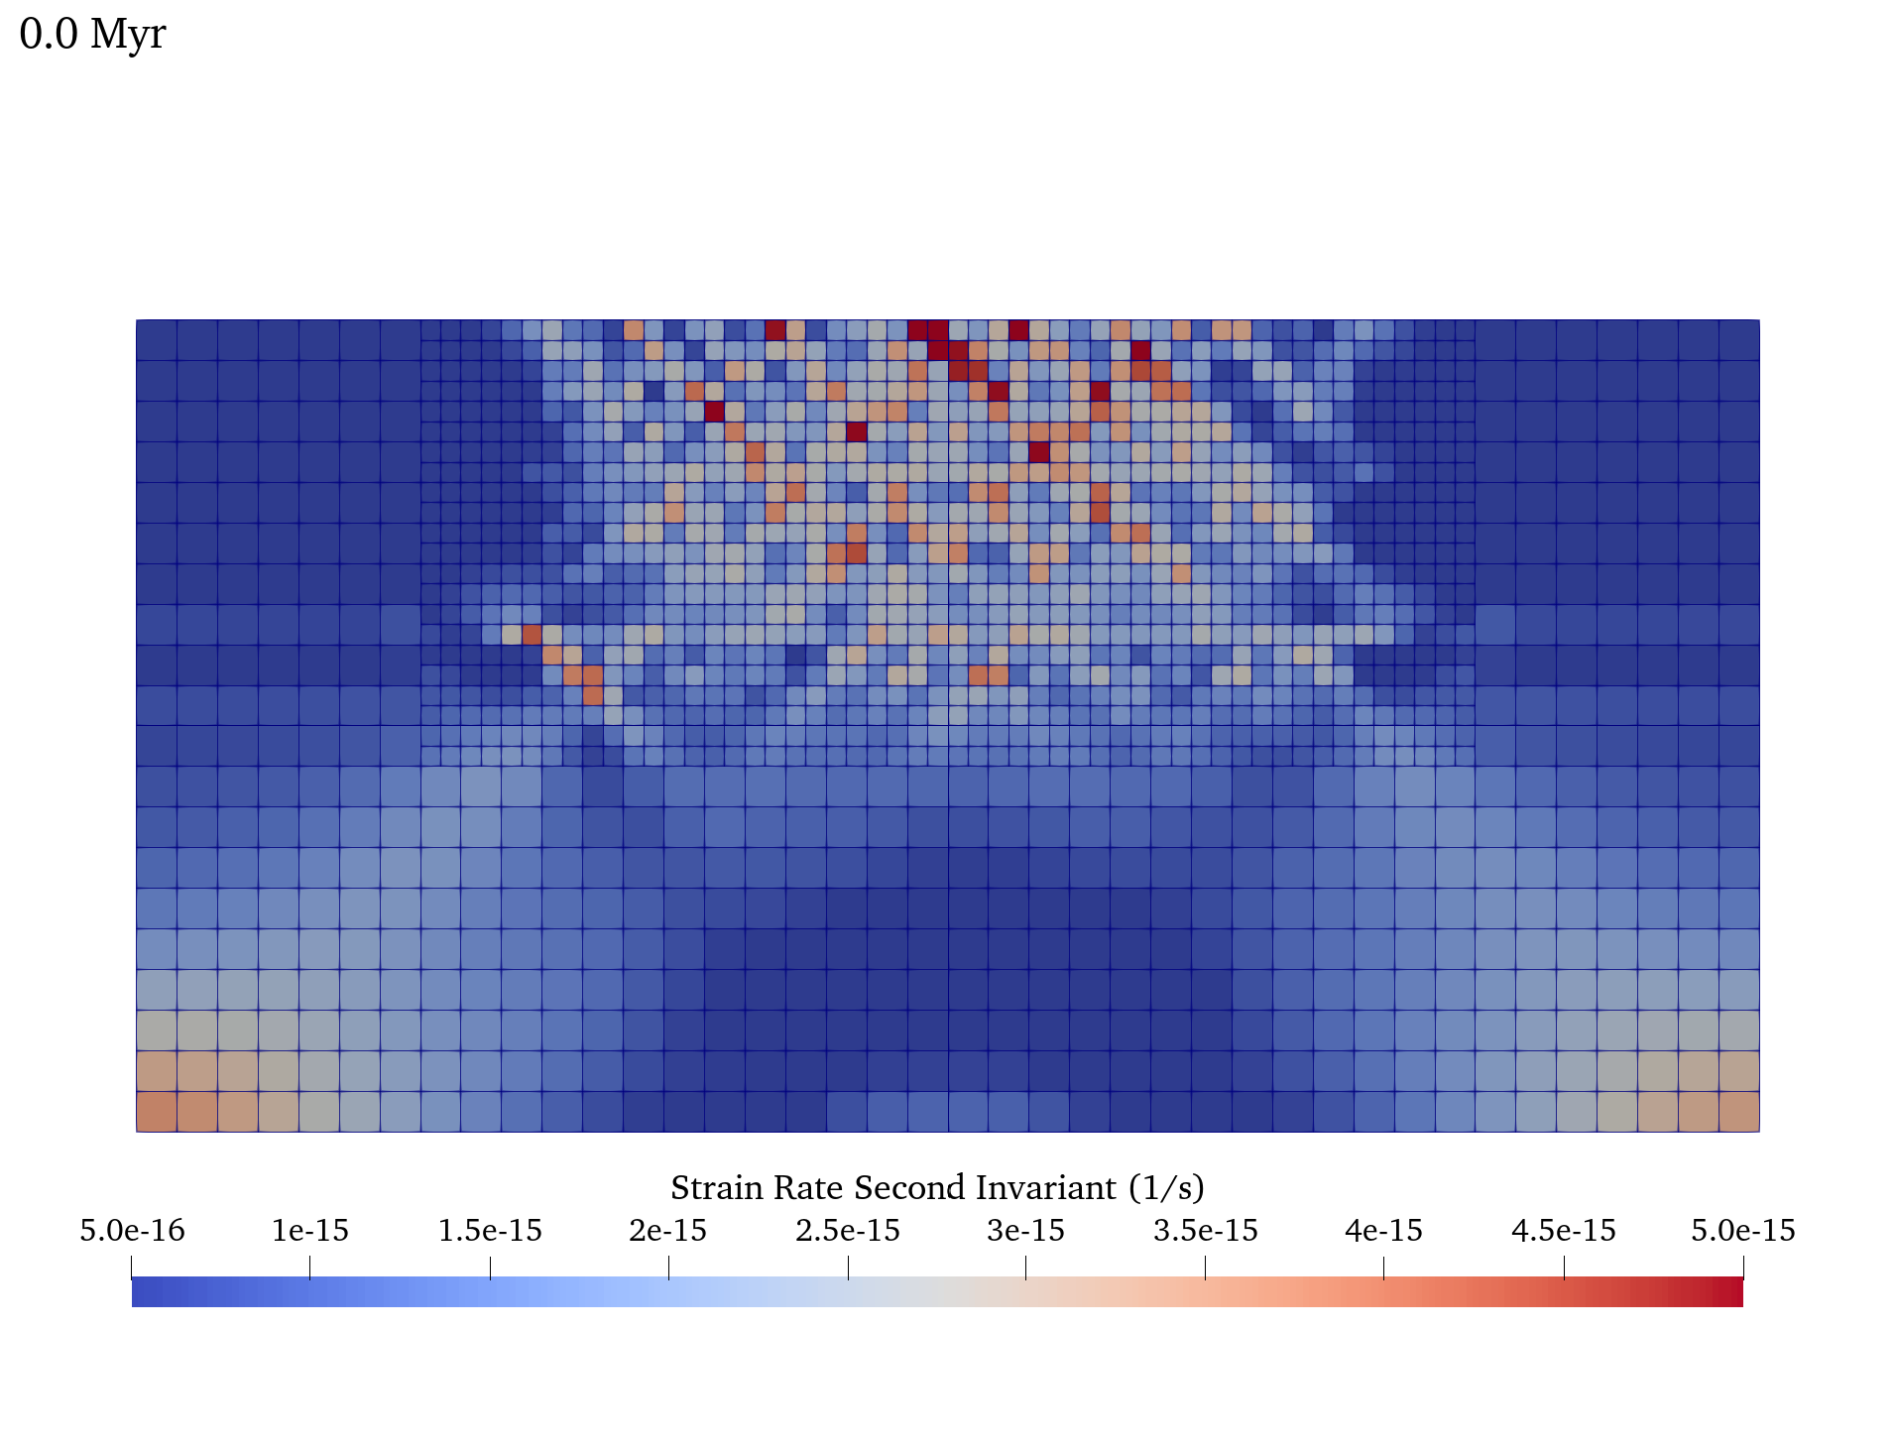
Modified Continental Extension Cookbook
Initial Deformation Field

Slide 48
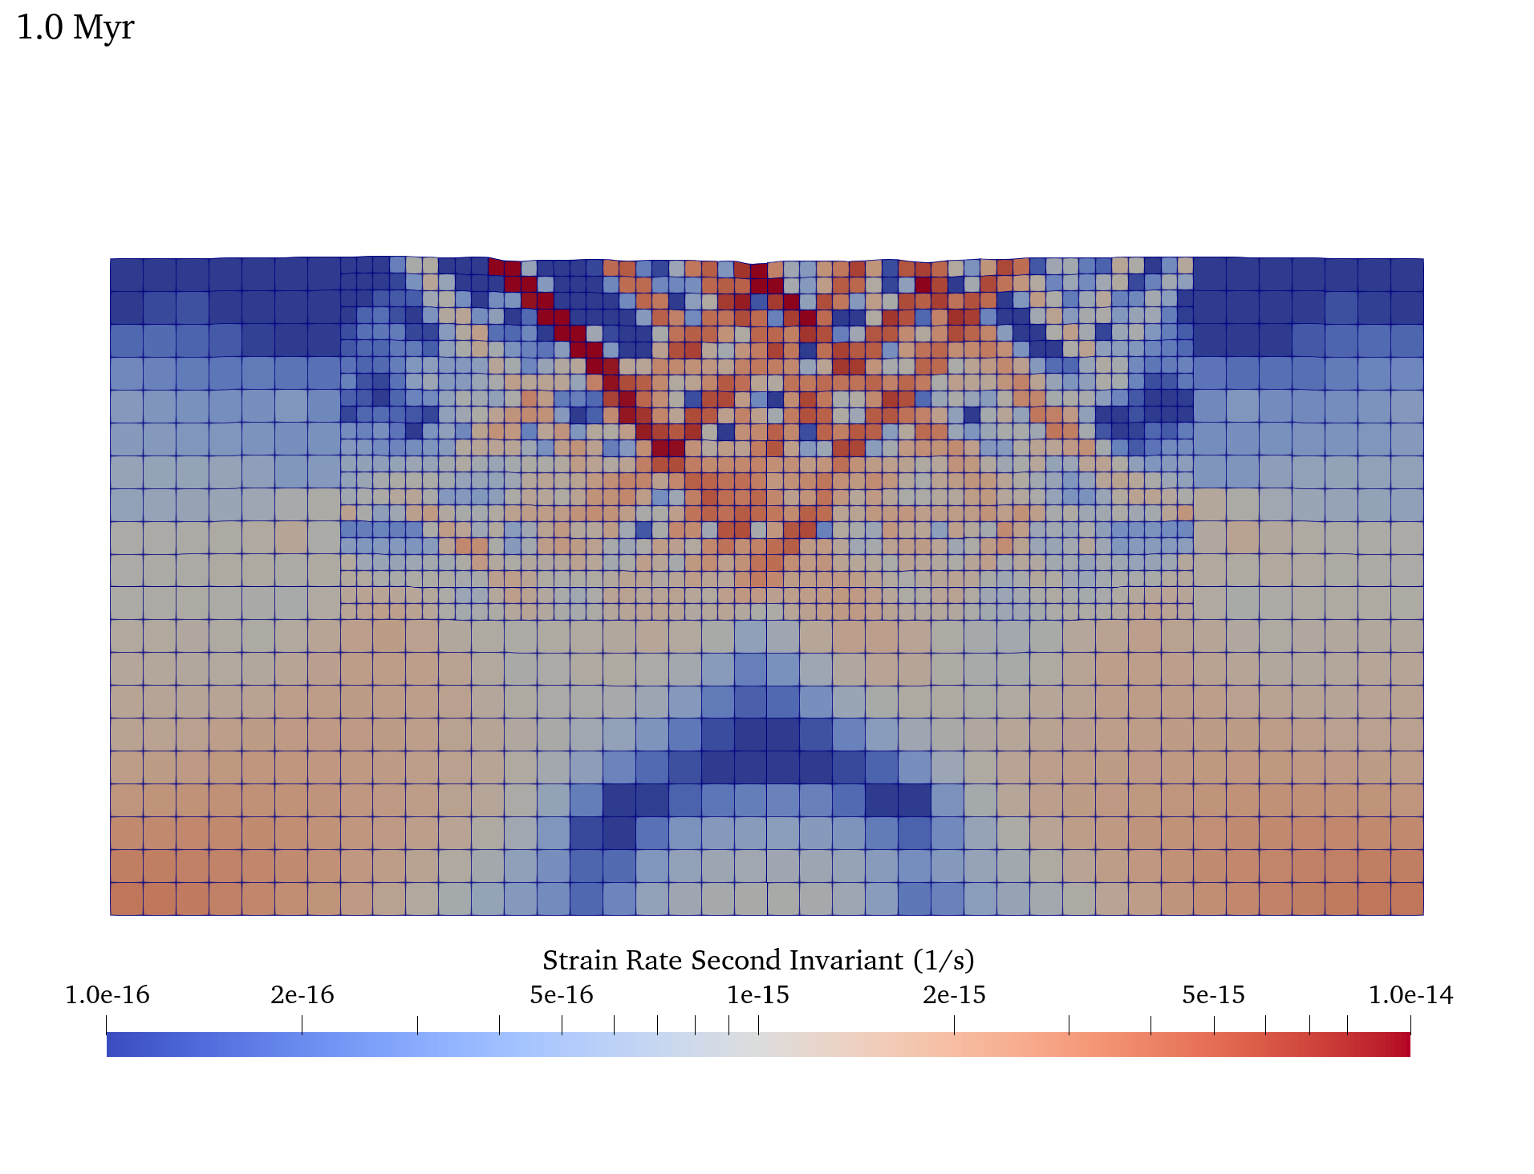
Modified Continental Extension Cookbook
Active Deformation Field

Slide 49
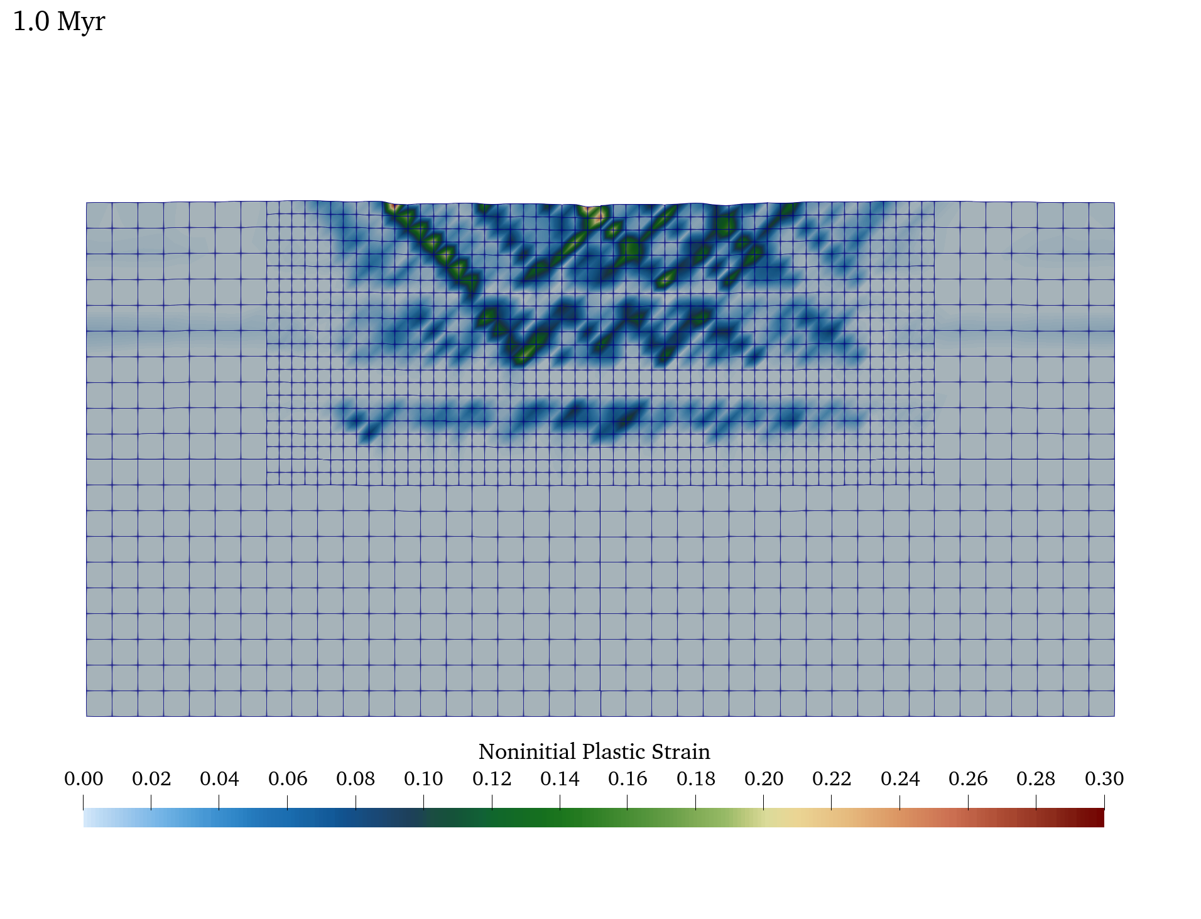
Modified Continental Extension Cookbook
Finite Deformation

Slide 50
Things to try during the break
ASPECT continental extension papers:
Glerum et al. (2020)
Naliboff et al. (2020)
Heron et al., (2019)
Grid resolution
Time-step Size
Model geometry
Initial lithology
Initial temperature
Initial plastic strain
Boundary conditions
Solver convergence settings
Viscous flow law
Brittle yield mechanism
Brittle parameters
Strain-weakening (magnitude, rate)
Elastic constants
$ASPECT_DIR/benchmarks/viscoelastic_plastic_shear_bands

Slide 51
In development & planned features
Peierls Creep
Particles and elasticity
Particles and free surface deformation
Free surface stabilization
Rate-state friction implementation
Compressible viscous flow and phase transitions (Visco Plastic)
Mesh-independent plasticity and partitioning of deformation mechanisms
Two-phase fluid with brittle failure*
Use of free surface with matrix free (GMG) solvers
Compressible elasticity

